Slide 1
DC-Art-GANS

Slide 2
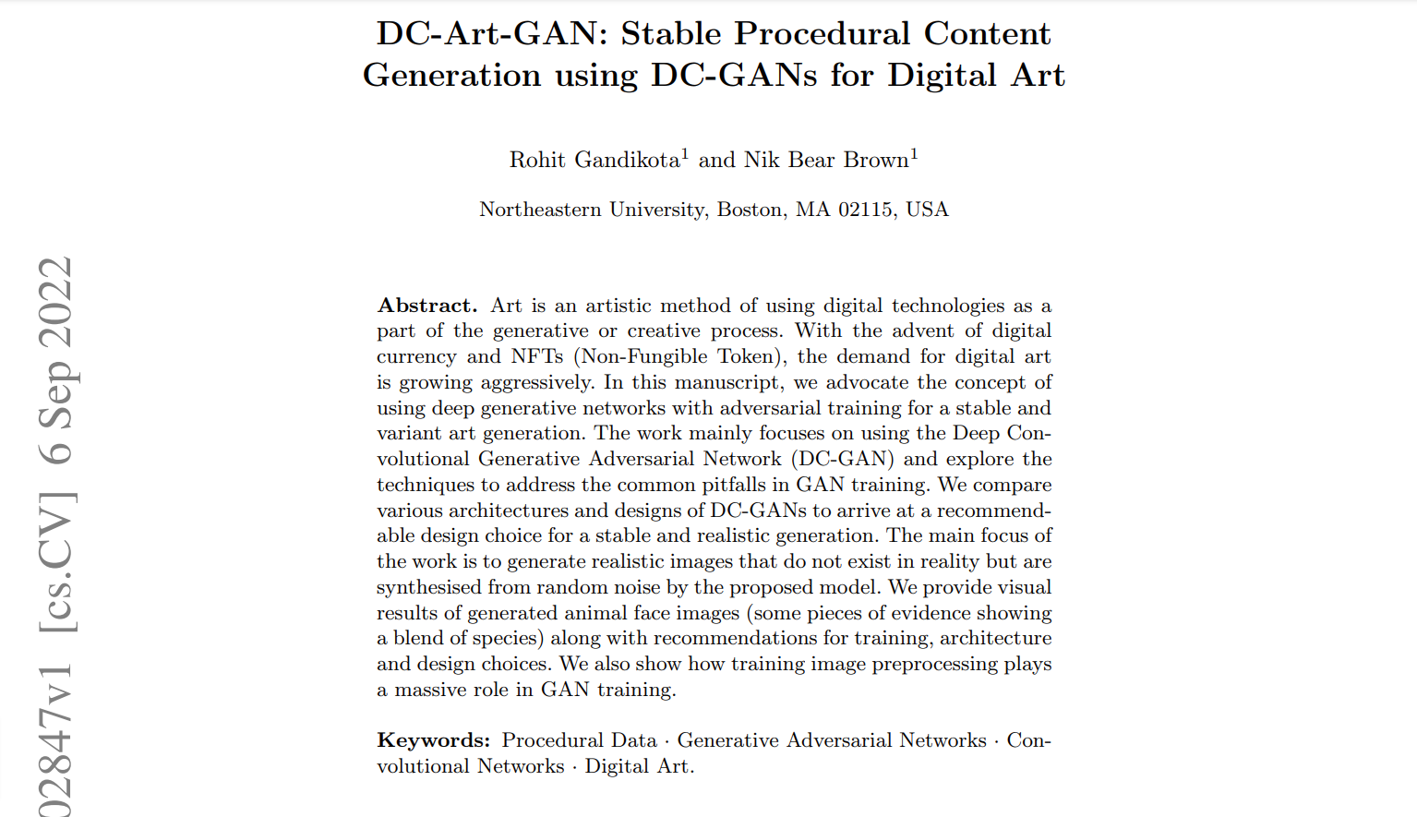
DC-Art-GAN: Stable Procedural Content Generation using DC-GANs for Digital Art
By,
Rohit Gandikota 1 and Nik Bear Brown 1
Northeastern University, Boston, MA 02115, USA
Date: 6 Sep 2022 at arxiv.org

Slide 3
GANS
Generative Adversarial Networks

Slide 4
GANs
Generative Model.
Data of any type - image, audio, video.
Applications: 3D object generation, image-to-Image, text-to-Image translation, super resolution, video prediction, data augmentation, face aging, enhancing AR, deep fakes, etc.

Slide 5
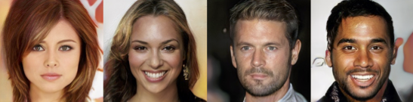
GANs - Timeline
WGAN,
CycleGAN,
ProGAN,
StarGAN,
Deep Fakes
Artificial Consciousness
Jurgen H Schmindhuber
SinGAN,
SAGAN,
StyleGAN2
StyleGAN3,
iWGAN,
OpenGAN
DCGANs
2014
2016
2018
2020
2022
… …
1990
2015
2017
2019
2021
Generative Adversarial Networks
Ian J. Goodfellow et. al.
Pix2pix,
StackGAN
RadialGAN,
BigGAN,
Progressive GAN,
StyleGAN
GAN-Attacks,
StyleGAN2-ADA,
GAN Space,
CircleGAN
…
…

Slide 6
GANs - Architecture
Real Data
Networks
Generative
Generator
Discriminator
Samples
Real
Noise
Fake!
Adversarial

Slide 7
Concept of Generator?
Notion of Data.
Anything can be represented as Numerical Data.
Data ➤ Distribution.
“Generator tries to approximate the distribution of real data.”

Slide 8
Poor Generator
●
●
●
●
●
●
●
●
●
●
●
●
●
●
●
●
●
●
●
●
●
●
●
●
●
●
●
Generated Sample Distribution
●
●
●
●
●
●
●
●
●
●
●
Real Sample Distribution
●
●
●
●
●
●
●
●
●
●
●
●
●
●
●
●
●
●
●
●
●
●
●
●
●
●
Discriminator
Decision Hyperplane

Slide 9
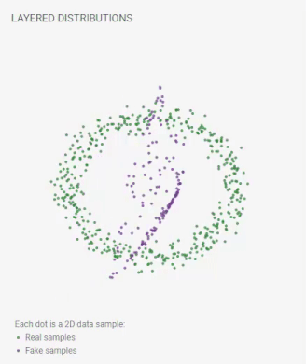
Good Generator
●
Generated Sample
●
Real Sample
●
●
●
●
●
●
●
●
●
●
●
●
●
●
●
●
●
●
●
●
●
●
●
●
●
●
●
●
●
●
●
●
●
●
●
●
●
●
●
●
●
●
●
●
●
●
●
●
Discriminator
Decision Hyperplane ???
●
●
●
●
●
●
●
●
●
●
●
●
●
●
●
●

Slide 10
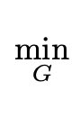
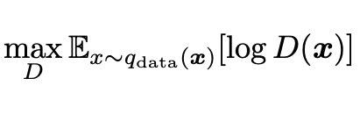
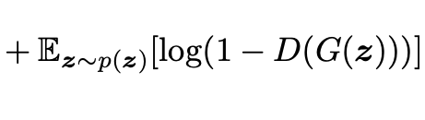
Training Objective
Generator should minimize this
Min-Max Game
~ Zero-Sum Game
Classification of Real Data
Classification of Fake Data
Discriminator tries to maximize these

Slide 11
Training Process
Proposal: Train Discriminator vastly then train Generator with that?
0
Doesn’t Matter
0
Gradients for Generator = 0
Proposal: Train Together

Slide 12
Cyclic Training
Train Discriminator
Generate fake samples.
Mix Real Data and Fake data.
Use Discriminator to classify Real/Fake.
Find Discriminator loss.
Update Discriminator weights ‘only’.
Train Generator
Generate fake samples.
Mix Real Data and Fake data.
Use Discriminator to classify Real/Fake.
Find Generator’s loss.
Update Generator weights ‘only’.

Slide 13
Nash Equilibrium
Generator
Cant do anything to improve its performance.
Nash Equilibrium
Discriminator
Cant do anything to improve its performance.

Slide 14
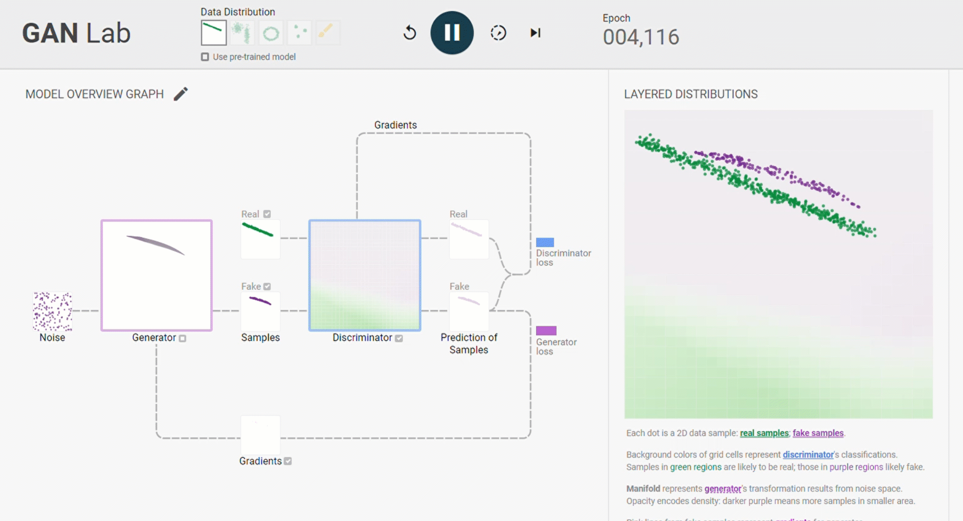
Real Time Visualization
https://poloclub.github.io/ganlab/

Slide 15
DC-Art-GANS

Slide 16
DC-Art-GANs
Deep Convolutional Art GANs
Main Focus: Generate Realistic Images.
GAN is a model.
DC-Art-GAN is implementing this model with Deep-Convolutional Architecture.
Only the Generator and Discriminator is of specific type.
Principle of GAN stays same.

Slide 17
Prerequisites
Images as Input?
Convolution?

Slide 18

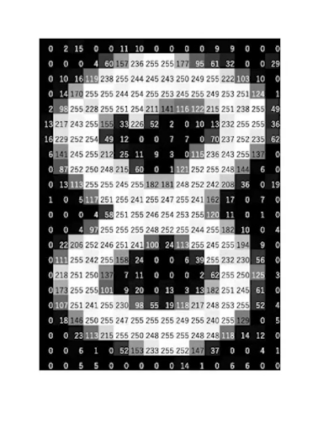
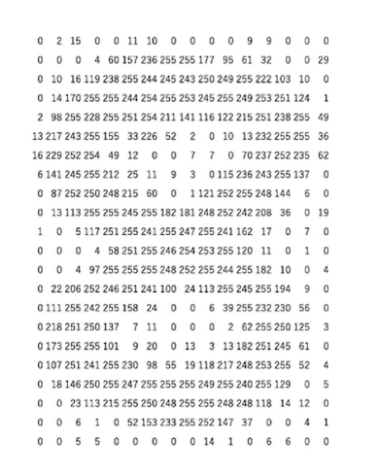
Image as a Matrix
Original Image
Pixel Values of Image
Matrix Representation

Slide 19
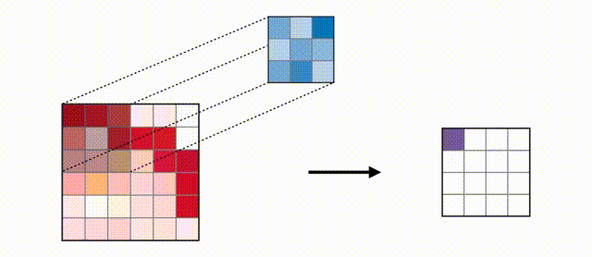
Convolution

Slide 20

Convolution

Slide 21
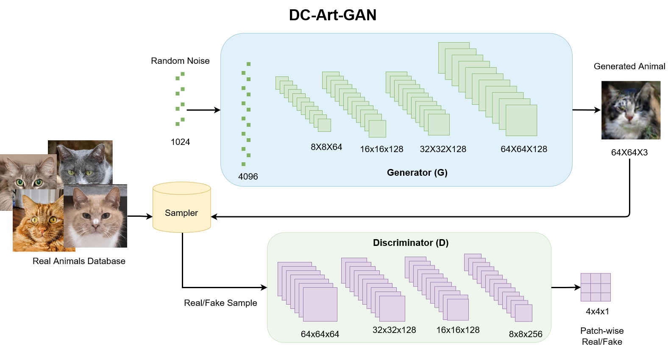
Discriminator Architecture
64x64x3
p=32
k=2x2x3
s=2
n=64
p=0
k=2x2x64
s=2
n=128
p=0
k=2x2x128
s=2
n=128
p=0
k=2x2x128
s=2
n=256
p=0
k=2x2x256
s=2
n=1

Slide 22
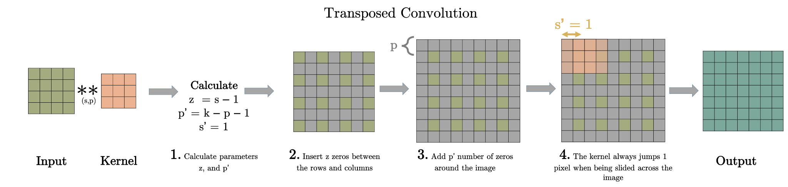
Fractionally Strided Convolution

Slide 23

Fractionally Strided Convolution

Slide 24
Generator Architecture
Dense
In: 1024 Out: 4096
Reshape
FSC
z=1
p’=1
k=3x3x64
s’=1
n=128
FSC
z=1
p’=1
k=3x3x128
s’=1
n=128
FSC
z=1
p’=1
k=3x3x128
s’=1
n=128
C
p=1
k=3x3x128
s=1
n=3

Slide 25
Complete Architecture

Slide 26
Proposed Points:
Sample-based normalization independent of dataset-parameters.
Removing complex batch-norm, dropout layers from generator.
Using LeakyReLU(0.2) instead of ReLU in Discriminator.
For every epoch of discriminator training generator is trained twice.
Patch-wise discrimination.
Low discriminator learning rate.

Slide 27
Implementation

Slide 28
Dataset used by Paper:
https://paperswithcode.com/dataset/afhq
https://paperswithcode.com/dataset/ffhq
https://paperswithcode.com/dataset/celeba-hq
Number of images: 16130
Dimension: 512x512 (RGB) [subsampled to 64x64(RGB)]
Classes: Cats, Dogs and Wild Animals ~ 5000 each.

Slide 29
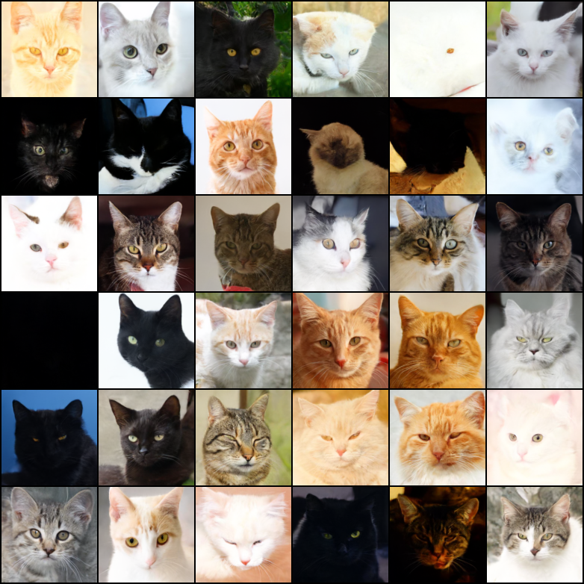
Training by Authors:
Number of Epochs: 30,000
Time taken: 2 Days
Device Used: -

Slide 30
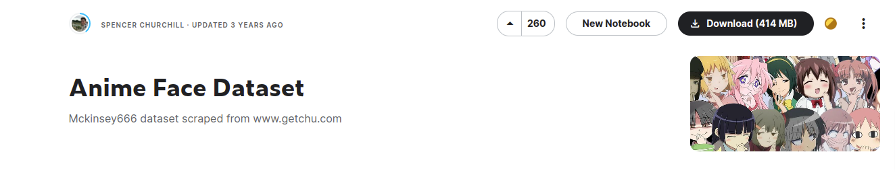
Dataset used for Seminar demo:
https://www.kaggle.com/datasets/splcher/animefacedataset
Number of images: 63,566
Dimension: Varied (RGB) [subsampled to 64x64(RGB)]

Slide 31
Training for Seminar demo:
Number of Epochs: 50
Time taken: ~2 Hours
Device Used: K80, P100, Tesla T4 [Google Colab GPU]

Slide 32
References & Links:
https://poloclub.github.io/ganlab/
https://jonathan-hui.medium.com/gan-why-it-is-so-hard-to-train-generative-advisory-networks-819a86b3750b
https://arxiv.org/pdf/1511.06434.pdf [Paper on DCGAN]
https://en.wikipedia.org/wiki/Generative_adversarial_network
https://people.idsia.ch/~juergen/FKI-126-90ocr.pdf [Artificial Curiosity 1990]
https://arxiv.org/abs/1406.2661 [Goodfellow et. al. 2014 GAN paper]
https://thispersondoesnotexist.com/ [StyleGAN example]
https://arxiv.org/pdf/1603.07285.pdf [convolutions]

Slide 33
Thank You.
Sai Ram!

